Slide 1

Machine Learning
Term Project
insights
EnergyFit: Realtime Energy Production Forecast App
Abdülmecid Demirhan | Muhammet Emin Meşe | Yunus Emre Aydın | Osman Djuraev | Mehmet Emir Selvi

Slide 2
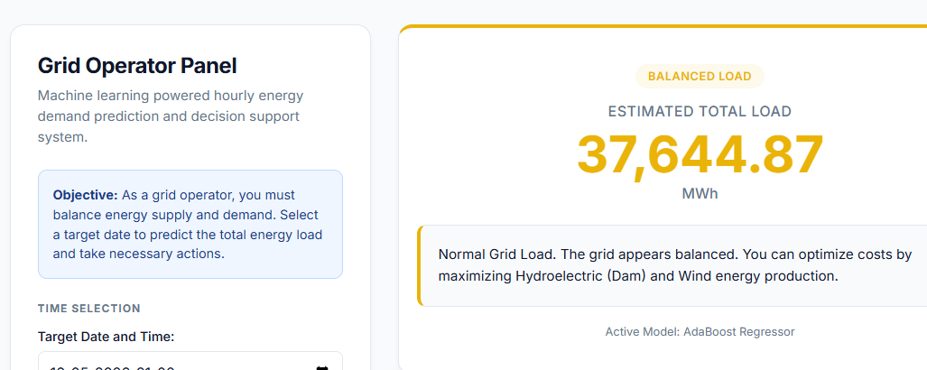
What is the problem?
Our Solution
Balancing supply and demand in the national electricity grid is highly challenging. Overproduction leads to energy waste and financial loss, while underproduction causes power outages (blackouts).
The "EnergyFit" application analyzes historical production and time data to predict the future hourly Total Energy Production Load using Machine Learning (Regression). Thus, it provides a strategic decision-support system for grid operators.
Abdülmecid Demirhan | Muhammet Emin Meşe | Yunus Emre Aydın | Osman Djuraev | Mehmet Emir Selvi

Slide 3
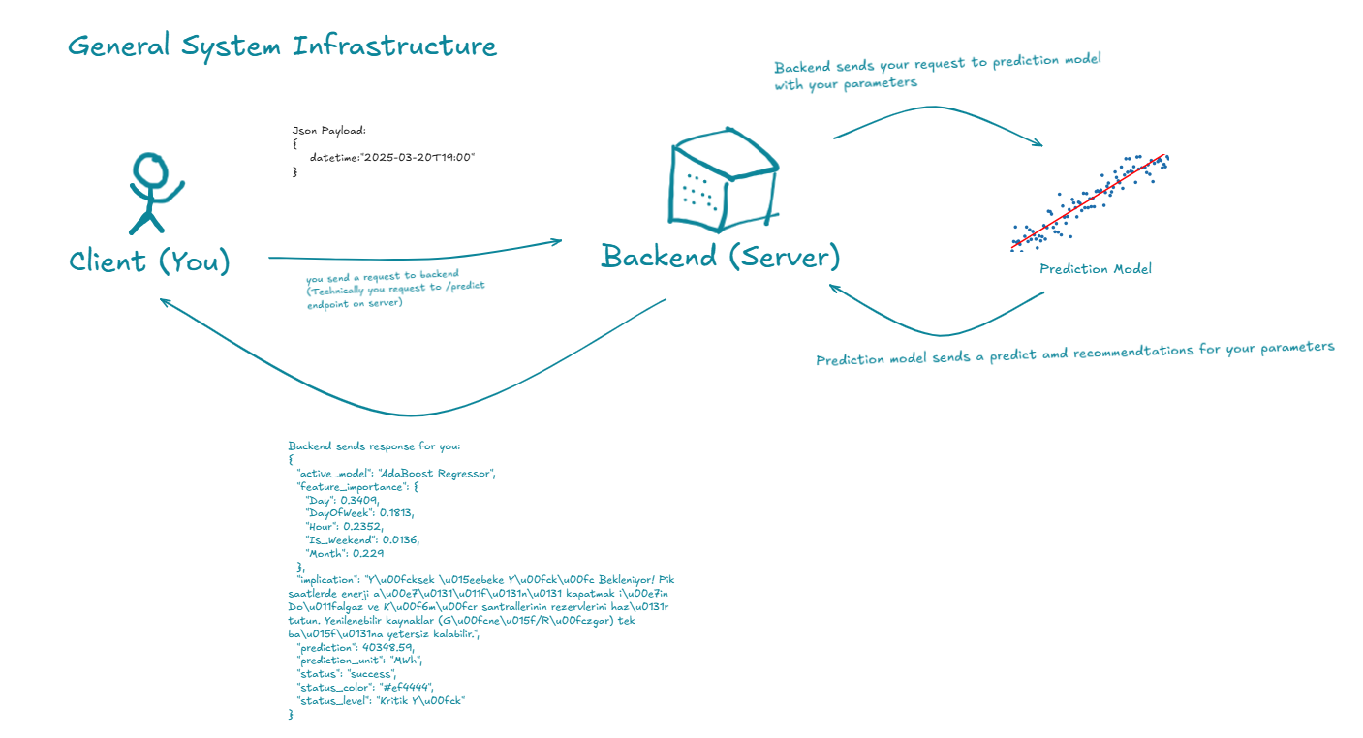
System Infrastructure:
Abdülmecid Demirhan | Muhammet Emin Meşe | Yunus Emre Aydın | İbrahim Sürensoy | Mehmet Emir Selvi

Slide 4
Our Dataset
Data: Real-time (hourly) energy production data from January 01, 2025, to April 01, 2025.
Volume: Thousands of hourly records spanning multiple months.
Features: Production amounts from energy sources like Natural Gas, Dam (Hydroelectric), Wind, Solar, along with "Date/Time" metrics.
Target Variable: Toplam (Total). Since this is a continuous numerical variable, we are solving a Regression problem.
Abdülmecid Demirhan | Muhammet Emin Meşe | Yunus Emre Aydın | Osman Djuraev | Mehmet Emir Selvi

Slide 5
Exploratory Data Analysis & Preprocessing
01. Summary Statistics
We analyzed the distribution of energy production across different hours and days. A clear daily seasonality was observed, with peaks during evenings and lows at night.
02. Missing Values
Instead of dropping rows and breaking time-series continuity, we filled missing values with the median value to preserve data integrity.
03. Scaling
All numerical features were standardized using StandardScaler. This ensures faster model convergence and prevents bias from different data scales.
Abdülmecid Demirhan | Muhammet Emin Meşe | Yunus Emre Aydın | Osman Djuraev | Mehmet Emir Selvi

Slide 6
How our system works? (Training Pipeline)
01. Data & Target
Predicting the "Total MWh" target using time data (Hour, Month, Day).
02. Preprocessing
Extracting meaningful features from date variables (Feature Engineering) and scaling them using StandardScaler for machine learning.
03. Tournament
Clash of Algorithms:
Linear Regression
AdaBoost Regressor
04. Optimization
Grid Search
Mathematically searching for hyperparameters to ensure AdaBoost delivers maximum performance.
05. Action Engine
Providing practical and strategic actions to the Grid Operator based on the prediction results.
Abdülmecid Demirhan | Muhammet Emin Meşe | Yunus Emre Aydın | Osman Djuraev | Mehmet Emir Selvi

Slide 7
Phase 1: Feature Engineering
train.py
# We extract patterns that the machine can understand from date and time data.
df['Tarih'] = pd.to_datetime(df['Tarih'], format='%d.%m.%Y')
df['Saat_Num'] = df['Saat'].str.split(':').str[0].astype(int)
# Time series features
df['Day'] = df['Tarih'].dt.day
df['Month'] = df['Tarih'].dt.month
df['DayOfWeek'] = df['Tarih'].dt.dayofweek
df['Is_Weekend'] = df['DayOfWeek'].isin([5, 6]).astype(int)
df['Hour'] = df['Saat_Num']
Abdülmecid Demirhan | Muhammet Emin Meşe | Yunus Emre Aydın | Osman Djuraev | Mehmet Emir Selvi

Slide 8
Phase 2: Model Tournament and Optimization
train.py
# We compete the models using RMSE and R² metrics
ada_base = AdaBoostRegressor(random_state=42)
param_grid = {
'n_estimators': [50, 100, 200],
'learning_rate': [0.01, 0.1, 1.0]
}
# We mathematically search for the best parameters using GridSearchCV
grid_search = GridSearchCV(estimator=ada_base, param_grid=param_grid, cv=5, scoring='neg_mean_squared_error')
grid_search.fit(X_train_scaled, y_train)
Abdülmecid Demirhan | Muhammet Emin Meşe | Yunus Emre Aydın | Osman Djuraev | Mehmet Emir Selvi

Slide 9
Phase 3: Deployment
train.py
# We select the model with the lowest error rate (highest R2)
if ada_r2 > lr_r2:
best_model = best_ada
else:
best_model = lr_model
# We package the model for our web application
with open('model_package.pkl', 'wb') as f:
pickle.dump(save_data, f)
Abdülmecid Demirhan | Muhammet Emin Meşe | Yunus Emre Aydın | Osman Djuraev | Mehmet Emir Selvi

Slide 10
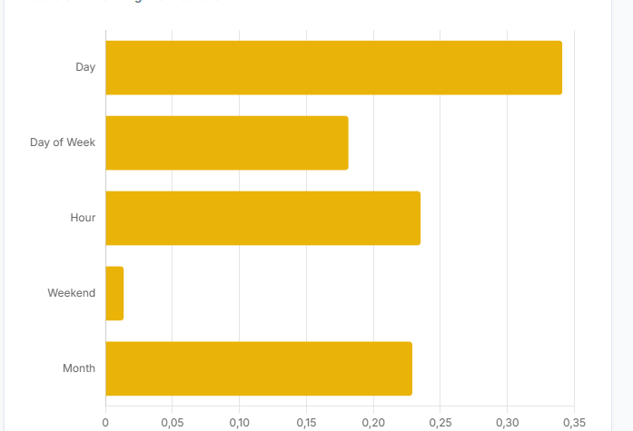
Factors Influencing the Decision (Feature Importance)
Explainable AI
Our AdaBoost model does not just make a prediction; it also explains what it based this prediction on.
Hour: The difference between daytime peak hours and nighttime hours is the most determining factor.
Weekend (Is_Weekend): A crucial factor that shifts production needs due to the drop in industrial consumption.
Abdülmecid Demirhan | Muhammet Emin Meşe | Yunus Emre Aydın | Osman Djuraev | Mehmet Emir Selvi

Slide 11
How our system works? (Example logs)
train.py
Loading data...
Performing data preprocessing and feature engineering...
--- Training Linear Regression ---
Linear Regression Results -> RMSE: 4812.75, MAE: 3873.57, R^2: 0.4006
--- Starting AdaBoost Grid Search---
AdaBoost Best Parameters: {'learning_rate': 1.0, 'n_estimators': 200}
AdaBoost Results -> RMSE: 3294.66, MAE: 2722.92, R²: 0.7191
[WINNER] Model: AdaBoost Regressor (R²: 0.7191, RMSE: 3294.66)
Model and components successfully saved as 'model_package.pkl'.
Abdülmecid Demirhan | Muhammet Emin Meşe | Yunus Emre Aydın | Osman Djuraev | Mehmet Emir Selvi

Slide 12
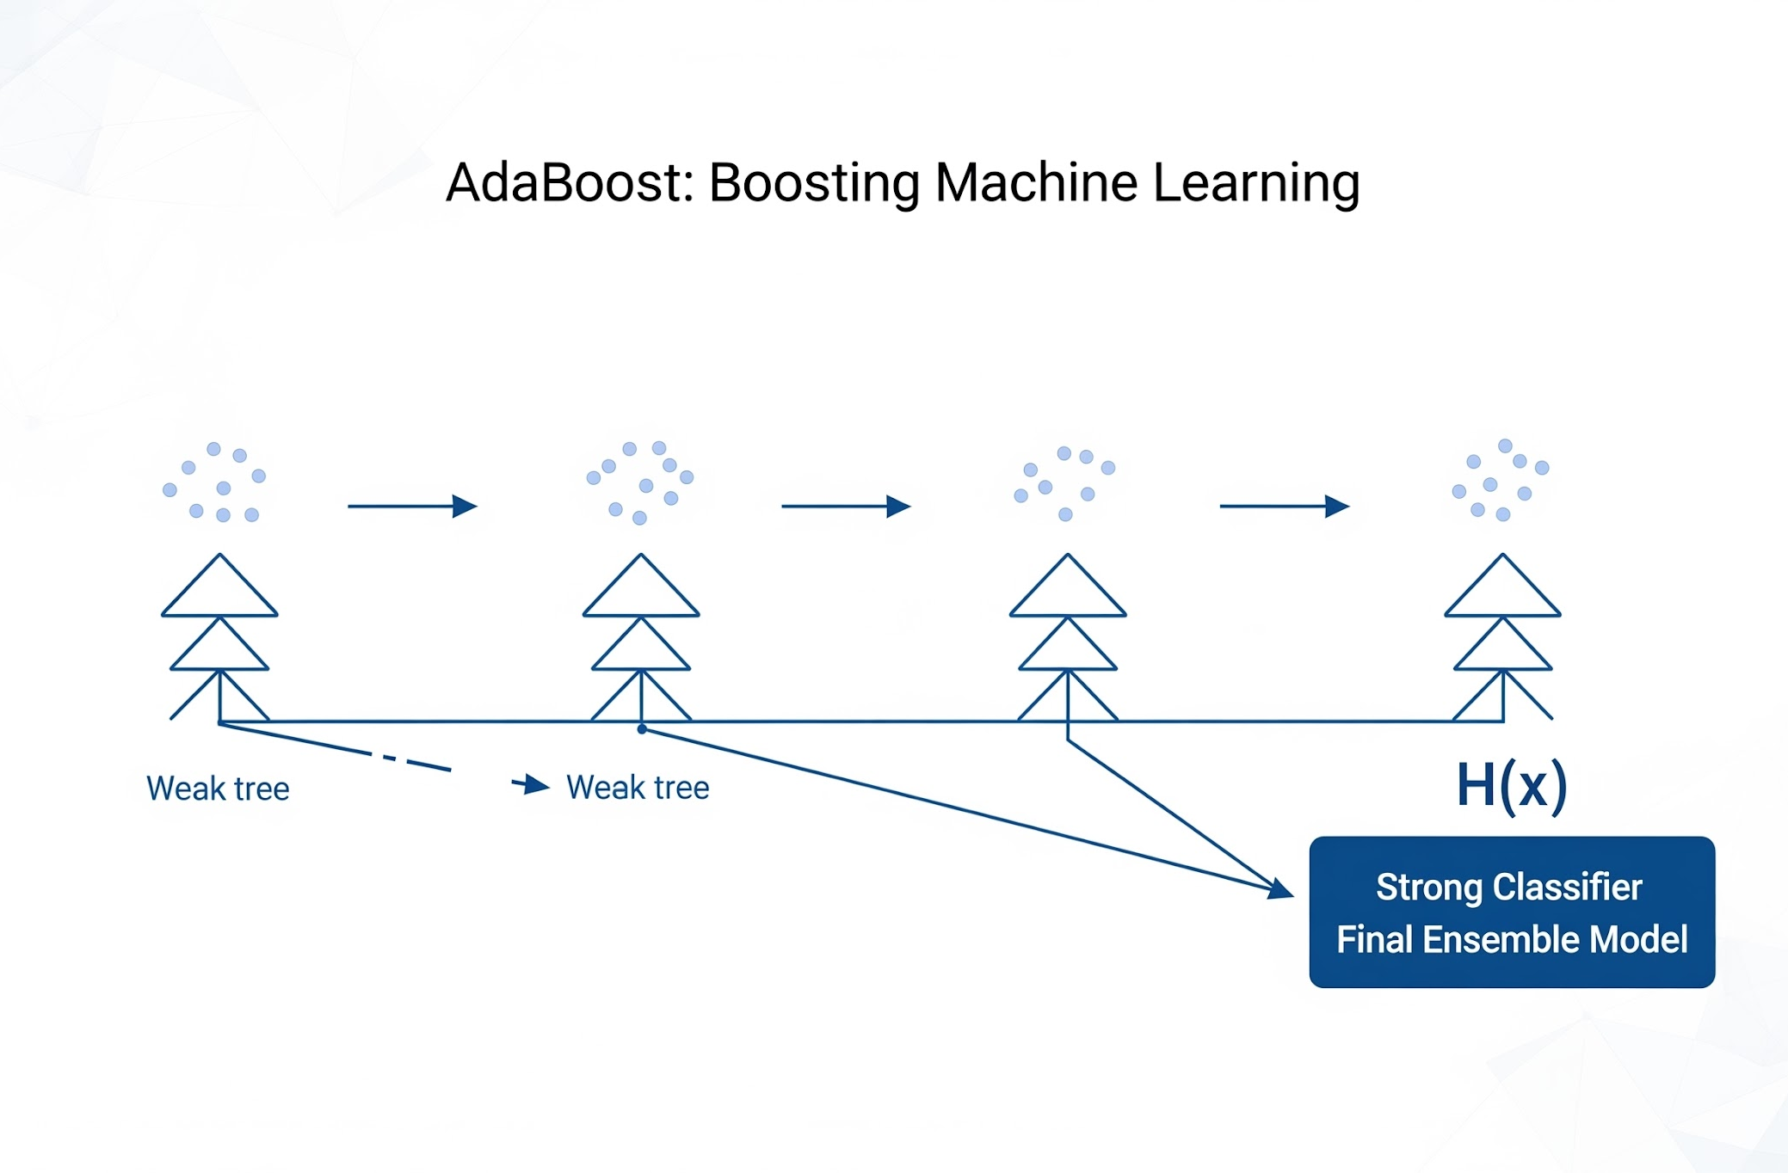
The Math Behind It: Ensemble and Boosting
Logic: A single model can sometimes fail to capture complex data patterns (Underfitting).
Solution (AdaBoost): The model sequentially trains hundreds of "Weak Learners" (Usually shallow decision trees). Each new tree focuses on the errors of the previous tree and tries to correct them.
Result: The combination of these weak learners creates an "Ensemble" that is highly powerful, flexible, and accurate.
Adaptive Boosting (AdaBoost) Mechanism
Abdülmecid Demirhan | Muhammet Emin Meşe | Yunus Emre Aydın | Osman Djuraev | Mehmet Emir Selvi

Slide 13
Scenario Application: Practical Implications
Our system doesn't just provide a Number; it generates a strategy for the Grid Operator:
1. Critical Load (>40,000 MWh): Peak hours where renewable energy won't suffice.
Action: Activate Natural Gas/Coal power plants.
2. Balanced Load (32,000 - 40,000 MWh):Routine demand.
Action: Optimize costs with Hydroelectric (Dam) and Wind power.
3. Low Load (<32,000 MWh): Nighttime or weekend hours.
Action: Prevent overproduction or activate storage (Pumped-storage) systems.
Abdülmecid Demirhan | Muhammet Emin Meşe | Yunus Emre Aydın | Osman Djuraev | Mehmet Emir Selvi

Slide 14
Time to Simple Demo
Abdülmecid Demirhan | Muhammet Emin Meşe | Yunus Emre Aydın | Osman Djuraev | Mehmet Emir Selvi

Slide 15
Winter Night Low Load
Input Values:
February 15, 2025 - 03:00 AM (Weekend)
Expected: Factories are closed, home lights are off. Low production estimate and a "Put base-load plants on standby" warning.
Abdülmecid Demirhan | Muhammet Emin Meşe | Yunus Emre Aydın | Osman Djuraev | Mehmet Emir Selvi

Slide 16
Weekday Peak Working Hour
Input Values:
March 20, 2025 - 07:00 PM (Weekday)
Expected: Critical hour when people return home and industry partially continues. Very high production estimate and a "Critical grid status, keep reserve plants ready" warning.
Abdülmecid Demirhan | Muhammet Emin Meşe | Yunus Emre Aydın | Osman Djuraev | Mehmet Emir Selvi

Slide 17
Thank You For Listening
Q&A Session
Why did AdaBoost win over Linear Regression?
Because the time/hour relationship is not always linear; it follows a complex fluctuation. AdaBoost captures this non-linear pattern very well.
What are our evaluation metrics?
Since we used Regression, we used RMSE, MAE, and R².
Abdülmecid Demirhan | Muhammet Emin Meşe | Yunus Emre Aydın | Osman Djuraev | Mehmet Emir Selvi

